Slide 1

Time Forecasting Models
Boaz | Allen | Harris
Notes:
Boaz Allen Harris was invited by Arion, an international retailer, to conduct an analysis of sales in their furniture division. Furniture sales take significant resources to manufacture and warehouse. Increasing the accuracy in forecasting future demand would have a significant improvement in Arion’s bottom line.

Slide 2
Arion Furniture Division
Skilled Labor Shortages
Increasing Costs
Fluctuating Consumer Demand
Supply Chain Issues
Notes:
Arion is concerned about the underlying trend and seasonality in their furniture sales division. The ability to project future sales will help them bring efficiencies to their manufacturing schedule and empower their marketing and sales teams. Since some of their furniture lines are manufactured domestically, Arion has to manage the following challenges:
Skilled labor shortages – near full employment is creating issues
Increasing costs – many states are phasing in increases in the minimum wage
Fluctuating customer demand – furniture sales are highly correlated to new home sales and new business creation. Any downturn in the economy slows furniture sales.
Supply chain issues – disruptions in material availability, trade wars, etc.

Slide 3
Good Forecasting Will…
Supply the right product at the right time and location
Minimize out-of-stock issues
Reduce inventory that is unsaleable

Slide 4
Arion Dataset
Notes:
Arion supplied us with a dataset of all their retail activity from 2014-2017. Our data science team worked in both Python and R to conduct the time series analysis

Slide 5
Furniture Sales Time Series
Notes:
There is clear seasonality to this time series and also a general upward trend line. The peaks get higher over time as do the valleys. There is a steep decline in sales in the early months of the year, relatively slow growth over the summer months and an increase in the fall through December.

Slide 6
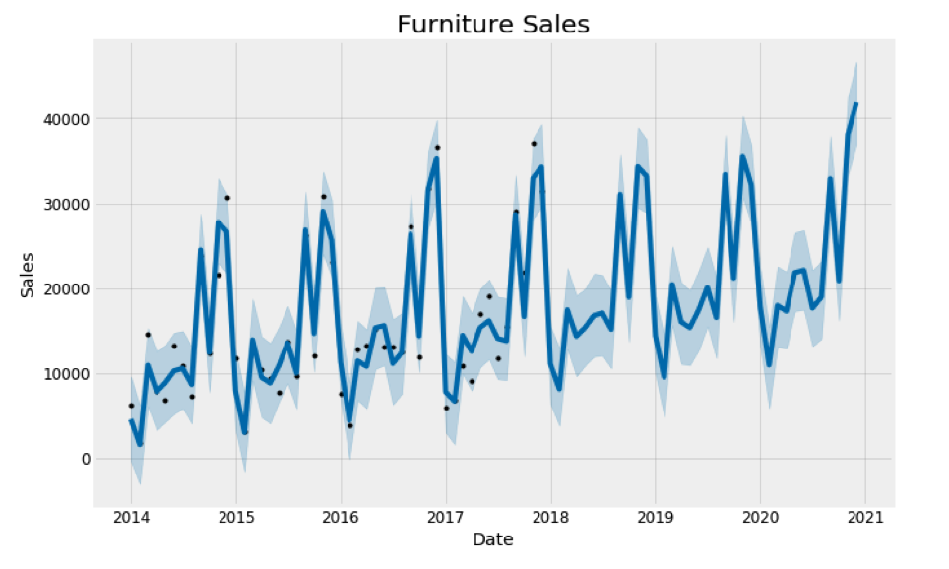
Notes:
Our first area of research was Facebook’s Prophet library. Their model is a decomposable model with three main elements: trend, seasonality and holidays. Since we are dealing with retail data this framework is an excellent choice for forecasting. The Prophet model was compared to the historical data (Dark blue line is forecasting spend numbers, black dots are the actual spend numbers. The light blue shade is 95% confidence interval around the forecast.). It captured all of the historical data points within its confidence intervals.

Slide 7
Notes:
Next we began exploring the data with different R software packages. This is a chart of the time series with different lags per month. Notice that the strongly positive lag 12. This confirms the strong seasonality of this time series.

Slide 8
Notes:
Our explorations with R software packages led to this forecast being selected as the best model. It is a multiplicative Holt-Winters’ method with multiplicative errors.

Slide 9
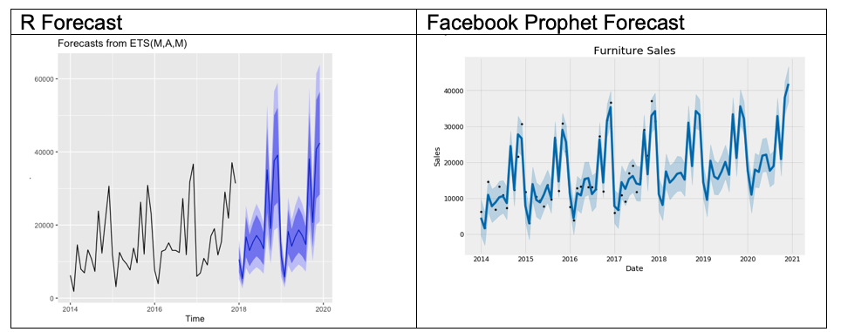
Notes:
There are interesting differences between the ETS(M,A,M) and the Facebook Prophet forecasts. The ETS model forecasts much higher spending, well above the 40,000 mark. The Prophet model is more conservative in its projections. The Prophet model was compared to the historical data (Dark blue line is forecasting spend numbers, black dots are the actual spend numbers. The light blue shade is 95% confidence interval around the forecast.). It captured all of the historical data points within its confidence intervals. Our team would recommend continuing to tune the Prophet forecast with additional information that is unique to Arion’s business model.

Slide 10
Final Comments
Boaz | Allen| Harris
Notes:
Boaz Allen Harris has provided a traditional forecast methodology utilizing the latest technologies available. But we do recommend that judgmental forecasting from Arion’s existing team or consultants from Booz Allen be added as an adjunct to these concluding observations. There is expert knowledge that can be applied to further increase the accuracy of these forecasting models.

